Slide 1
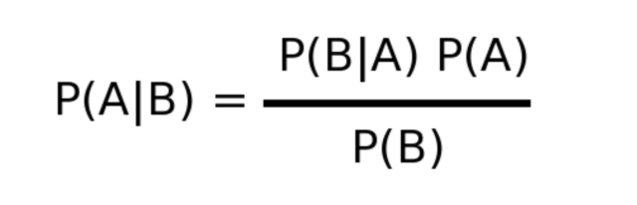
Naïve Bayes classifier

Slide 2
Answer this
Sherish is 29. She is a LLB graduate and also majored in philosophy. She likes to read about history and often has deep interested in studying racism and other forms discrimination that had happened in the medieval period. She is also a part of an NGO which works in the up liftment of rural women.
Sherish is a banker.
Sherish is a banker and also a feminist.

Slide 3
Now consider proportions
Feminists
Bankers

Slide 4
Now re consider the scenario and lets say 100 people fits the description
___ out of 100 are bankers.
___ out of 100 are banker and feminists.

Slide 5
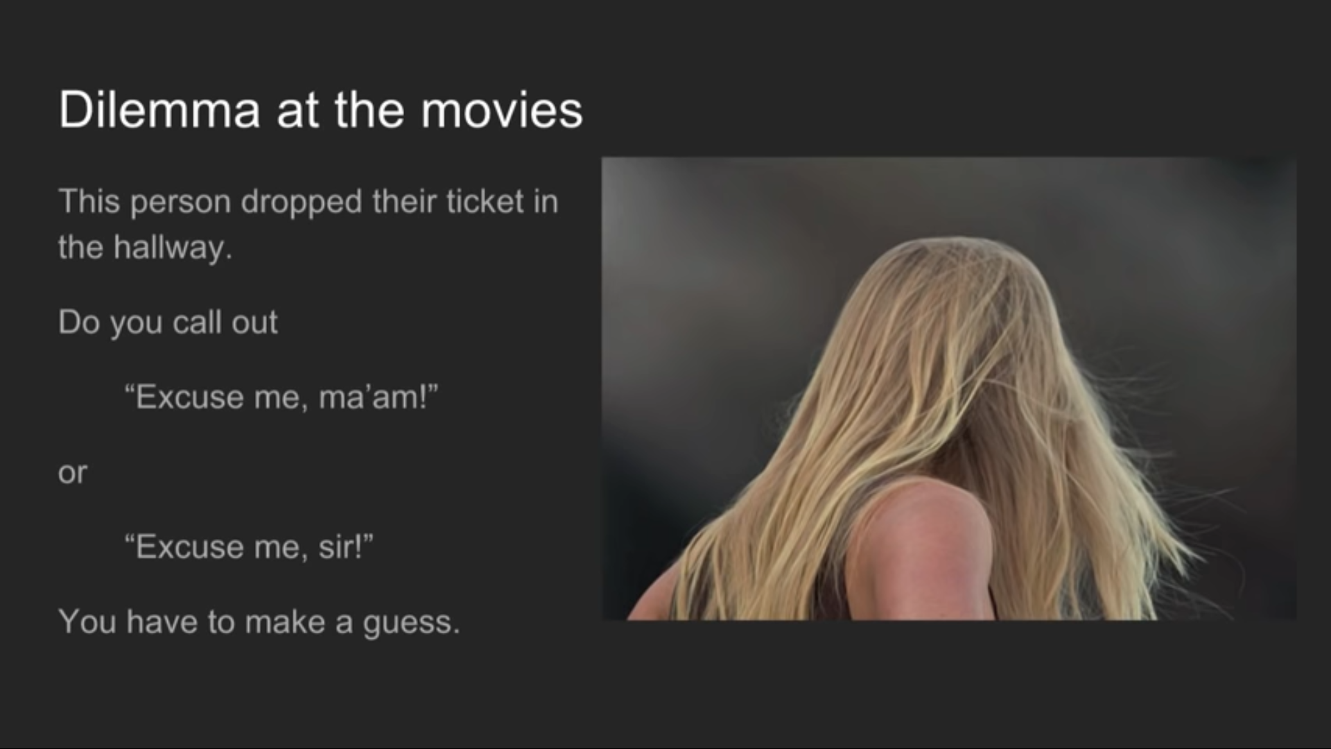

Slide 6
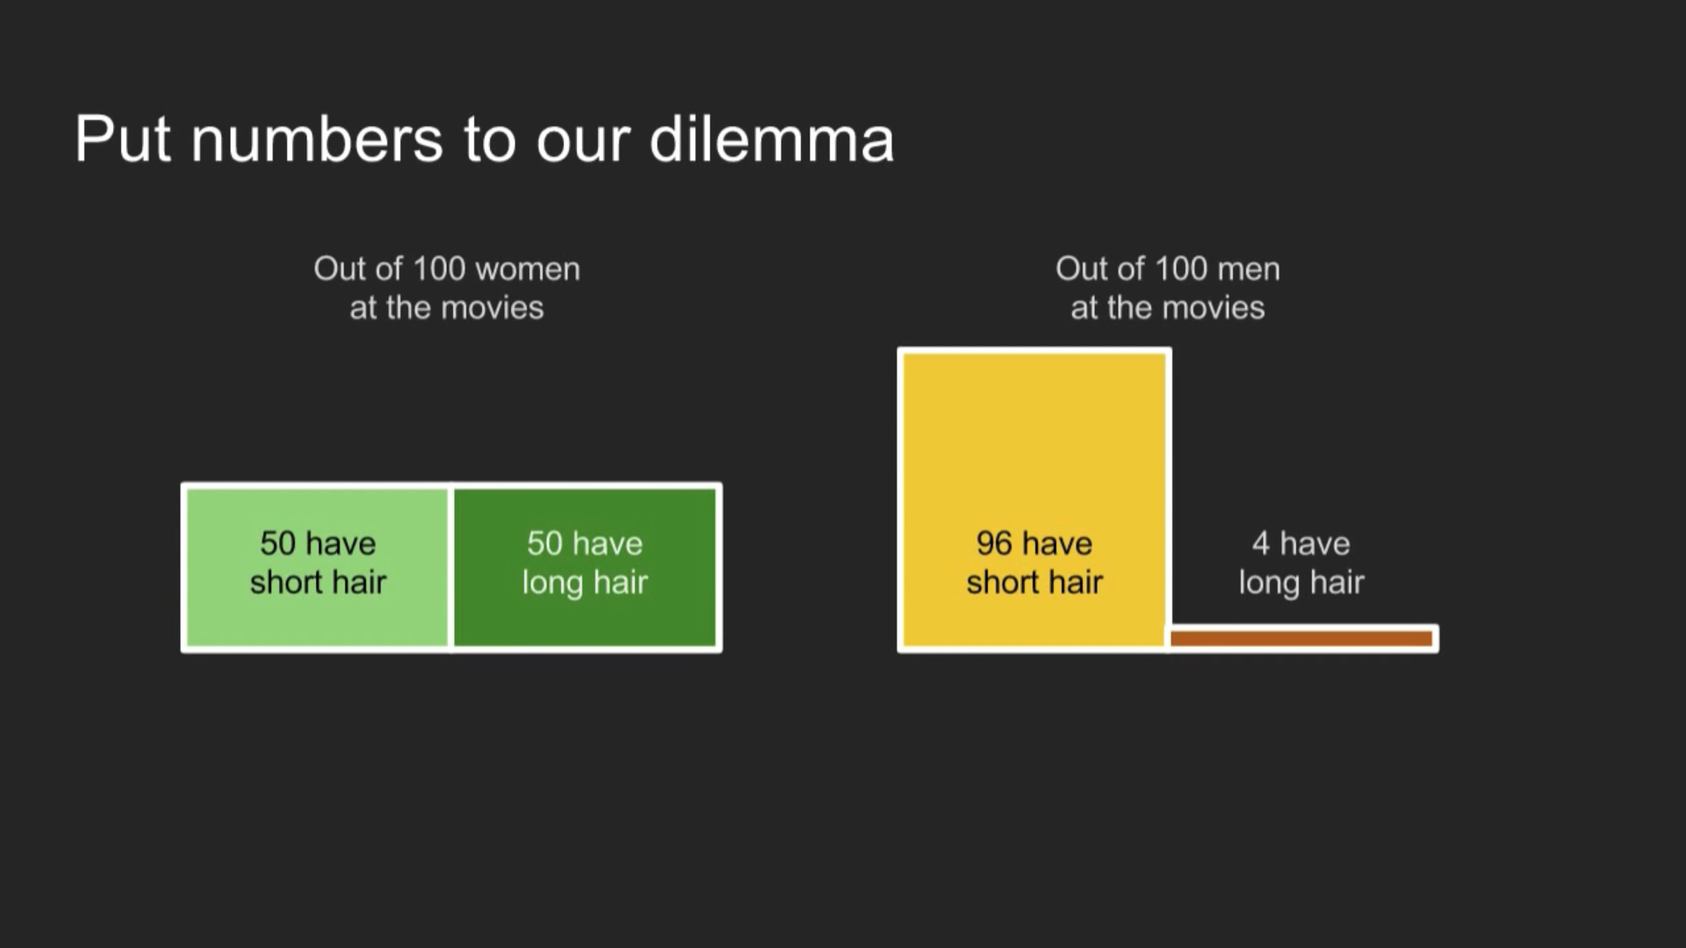

Slide 7
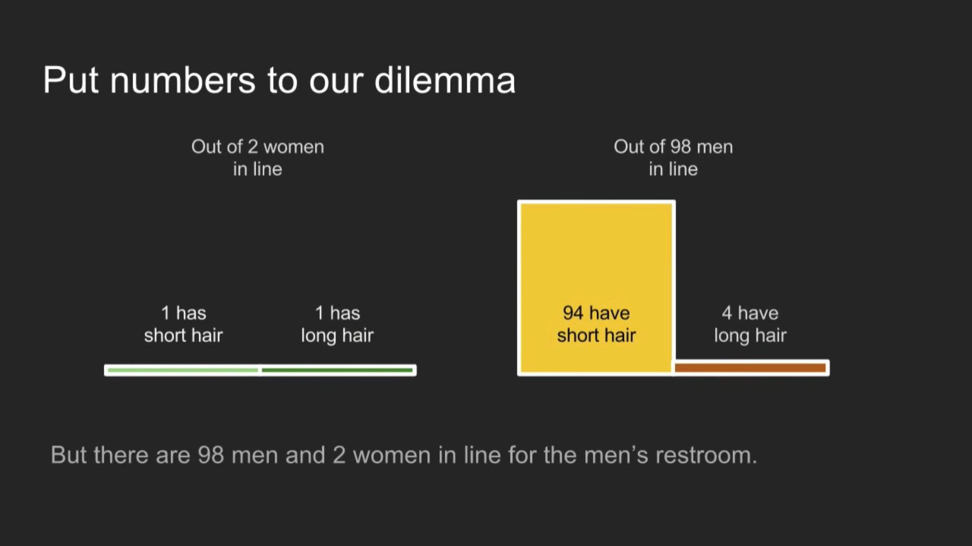

Slide 8
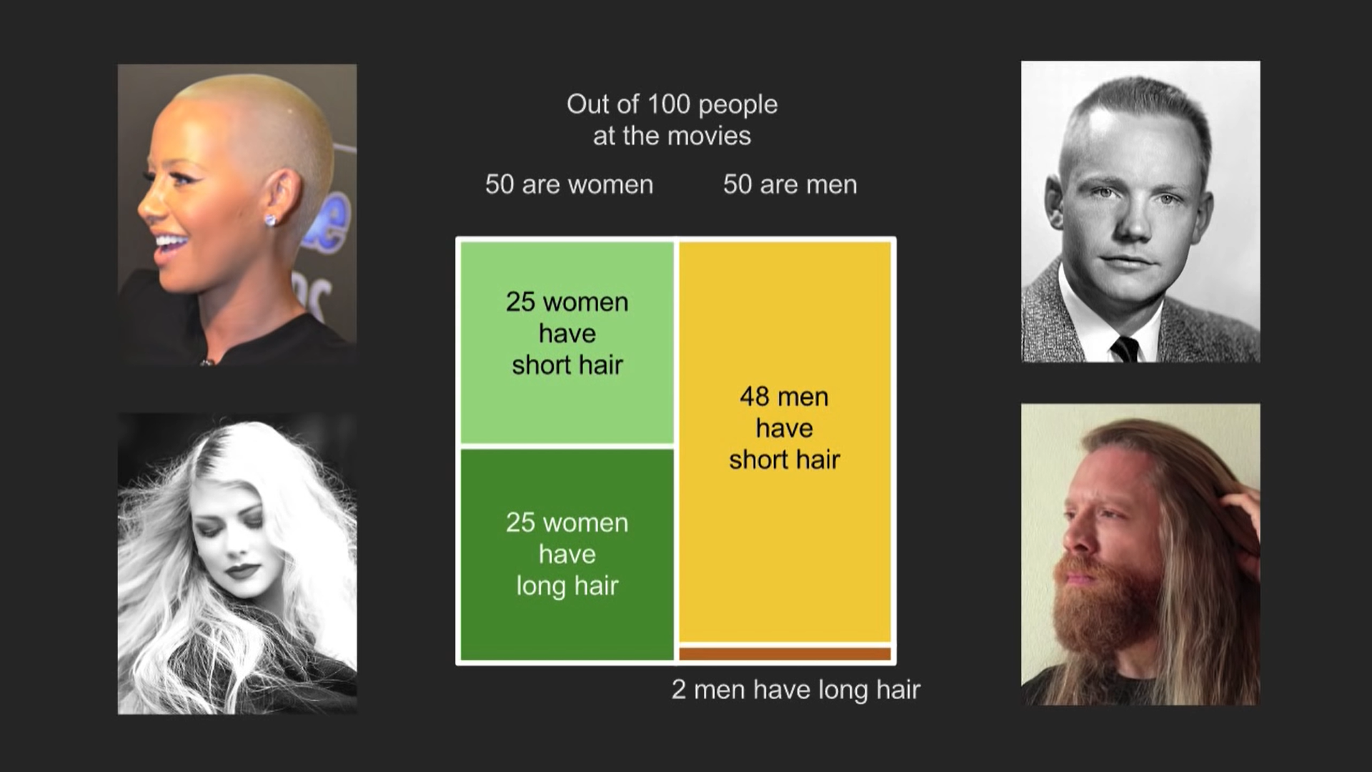

Slide 9
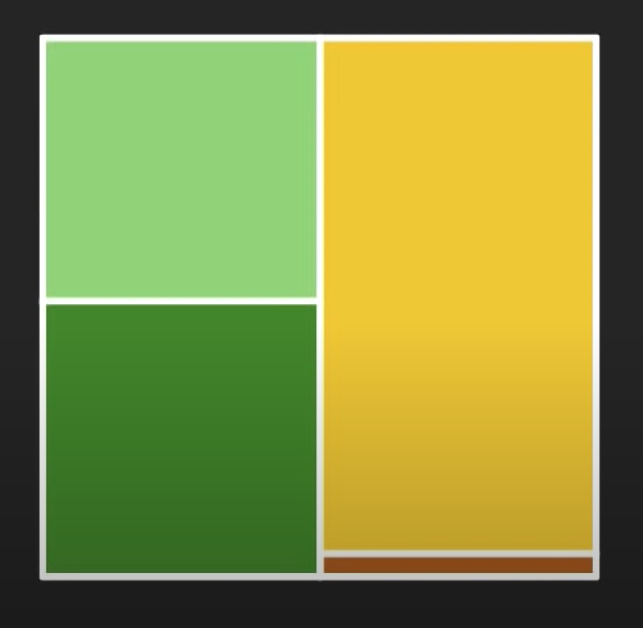
Lets now jump into the math
P(Woman) = Total # women / Total # people
= 50/100
= 0.5
P(Man) = Total # men / Total # people
= 50/100
= 0.5

Slide 10
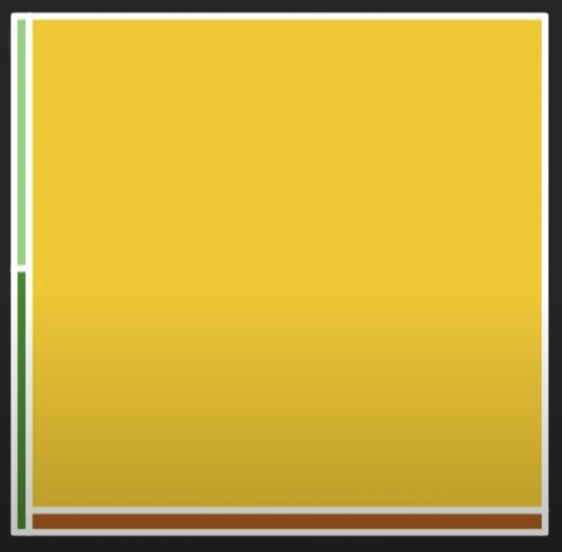
Restroom scenario
P(Woman) = Total # women / Total # people
= 2/100
= 0.02
P(Man) = Total # men / Total # people
= 98/100
= 0.98

Slide 11
Conditional probabilities(Extra information)
P (long hair | woman ) = If I know that the person is woman, what is the probability that the person has a long hair?
P(long hair | woman ) = # women with long hair / # of women
= 25/ 50 = 0.5
For the restroom scenario
P(long hair | woman ) = 1 / 2 = 0.5

Slide 12
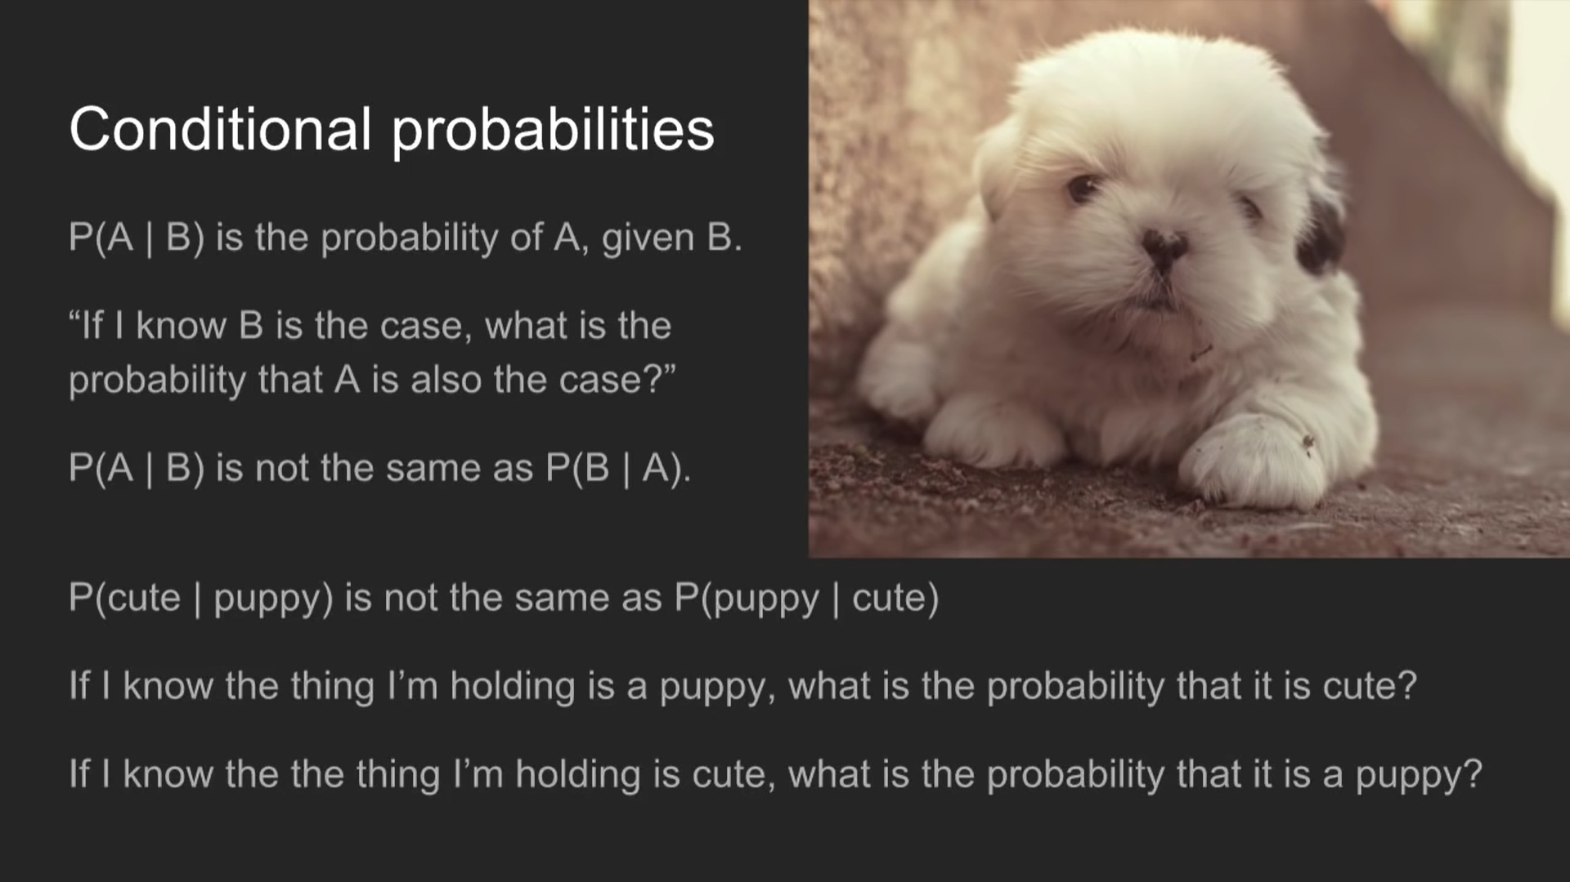
Conditional probabilities

Slide 13
What is the probability that the person has both short hair and is a woman
P(Woman and short hair) = P(Woman)*P(Short Hair | woman)
= 0.5*0.5 = 0.25
For men’s restroom scenario.
P(Man and long hair) = P(Man)*P(Long hair | Man)
= 0.98*0.04 = 0.392

Slide 14
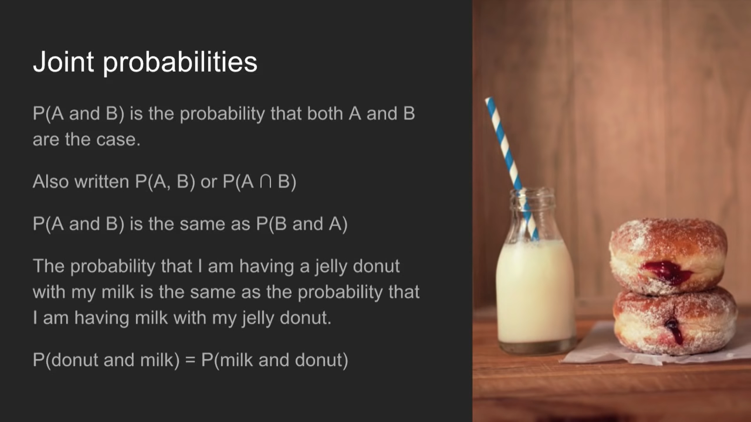
Joint probabilities

Slide 15
Bayes theorem
P( Man and Long Hair) = P(Long Hair)*P(Man| Long Hair)
P( Long Hair and Man) = P( Man) * P (Long Hair | Man)
Now, logically #1 and #2 mean the same thing
So, P(Long Hair)*P(Man| Long Hair) = P( Man) * P (Long Hair | Man)
P( man | long hair) = P( Man) * P (Long Hair | Man) / P( long hair)

Slide 16
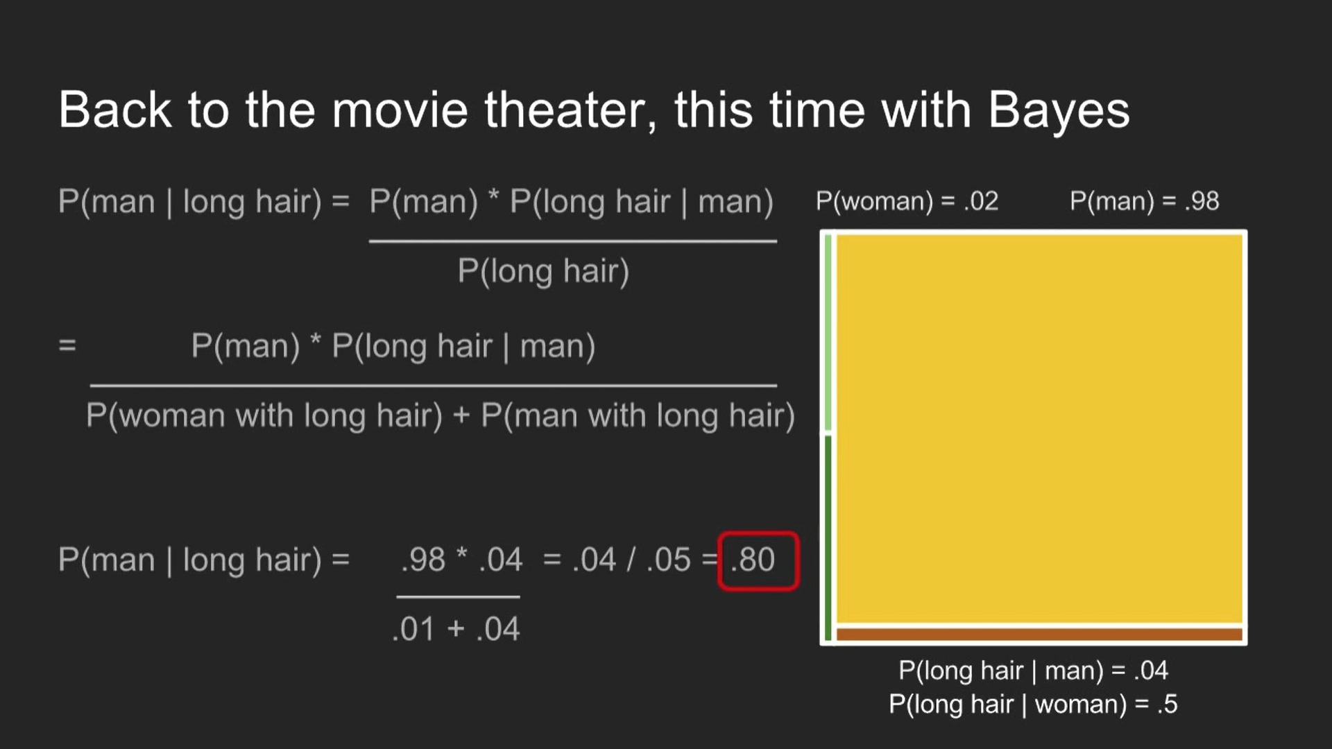

Slide 17
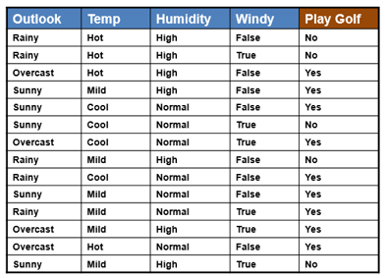
Q. What is the probability that one should play golf given that it is sunny?
Hint : Use Bayes Theorem

Slide 18
P(Yes | Sunny) = P( Sunny | Yes) . P(Yes)
P(Sunny)

Slide 19
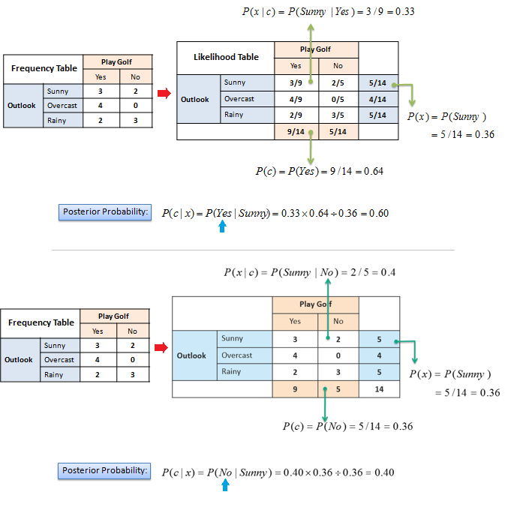
The posterior probability can be calculated by first, constructing a frequency table for each attribute against the target. Then, transforming the frequency tables to likelihood tables and finally use the Naive Bayesian equation to calculate the posterior probability for each class. The class with the highest posterior probability is the outcome of prediction.
Example, given the data should we play on a sunny day or not?

Slide 21
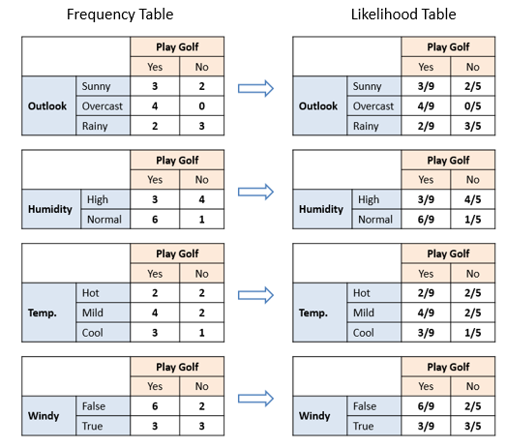

Slide 22
P(Yes | Sunny & Hot) = P( Sunny | Yes). P( Hot | Yes) . P(Yes)
P(Sunny). P(Hot)

Slide 23
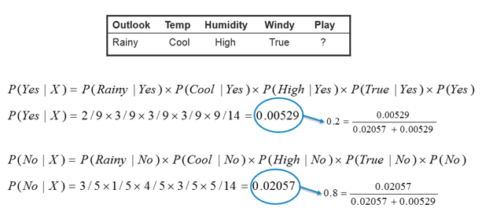
In this example we have 4 inputs (predictors). The final posterior probabilities can be standardized between 0 and 1.

Slide 24
1.Gaussian NB: It should be used for features in decimal form. GNB assumes features to follow a normal distribution.
2.MultiNomial NB: It should be used for the features with discrete values like word count 1,2,3...
3.Bernoulli NB: It should be used for features with binary or boolean values like True/False or 0/1.

